Slide 1
ALL-ACCESS
Notes:
Narration: Welcome to the events portion of the All Access Module! I am Stacey Malaret, Director for the LEAD Scholars Academy. This powerpoint will show you how to find events and how to upload them using your student portal.
As a reminder, LEAD Scholars are required to attend two LEAD events and two Impact events each semester, perform the required number of service hours as well as one Leadership Week event in the spring along with LEAD All Access in the fall.

Slide 2
Where do I find LEAD & Impact Events?
Weekly reminders in the LEAD Scholar Holler
The white board in the LEAD Lounge
Our public calendar on the website lsa.sdes.ucf.edu/lead
Your student portal!
Click the calendar button!
Notes:
Narration: The most common questions students ask at the front desk are how to find events, forms, and where to upload attendance. So let’s go over all of your options!
The LEAD Scholar Holler newsletter is sent once a week and provides valuable event, internship, scholarship, and leadership position announcements. Make sure to read it weekly and check your junk mail in case it is sent there!
A white board in the LEAD Lounge will update weekly or bi-weekly with both Impact and LEAD events.
Our public calendar can be found by visiting our website and clicking on the calendar button.
But the best place to go is your student portal!

Slide 3
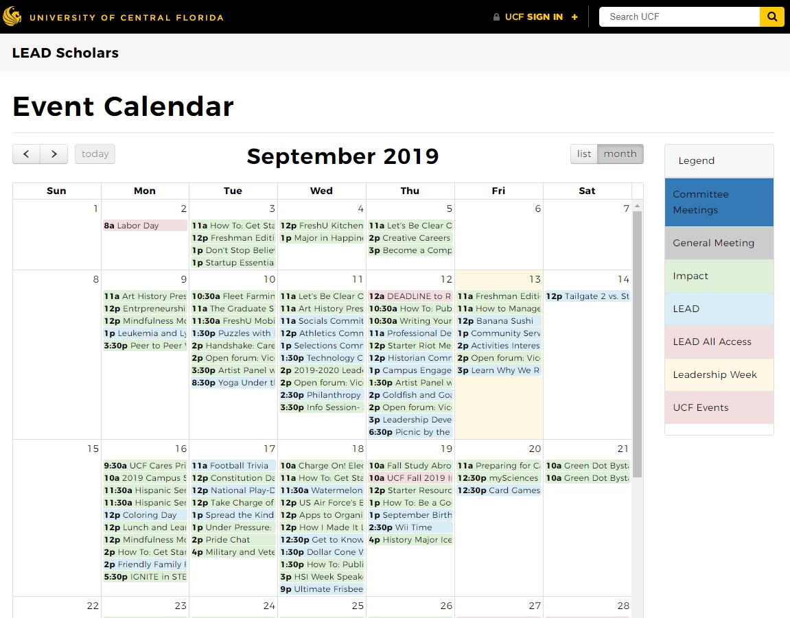
Notes:
Narration: Before we look at the portal, I want to explain the calendar. This is the LEAD Scholar internal calendar and will include various events. Impact events – events that are held at UCF that deal with your development as a student – are in the green boxes. LEAD events are blue, and Leadership week events are yellow. If you click on any of the specific events, a dialogue box will open with the description, which might include special submission requirements for attendance so please make sure to check!

Slide 4
Meet your student portal!
Notes:
Narration: This is your student portal!
You can log into your portal by going to lead.sdes.ucf.edu/students and logging in with your NID and password: basically how you log into myUCF!
The portal is where you can find your LEAD course breakdown, leadership positions, LEAD specific scholarships, and your current event credit status. Make sure you take the time to check it out!

Slide 5
See all posted events!
Notes:
Narration: In the same ribbon as your name, you will find three links. The first will take you to the same calendar we saw earlier!

Slide 6
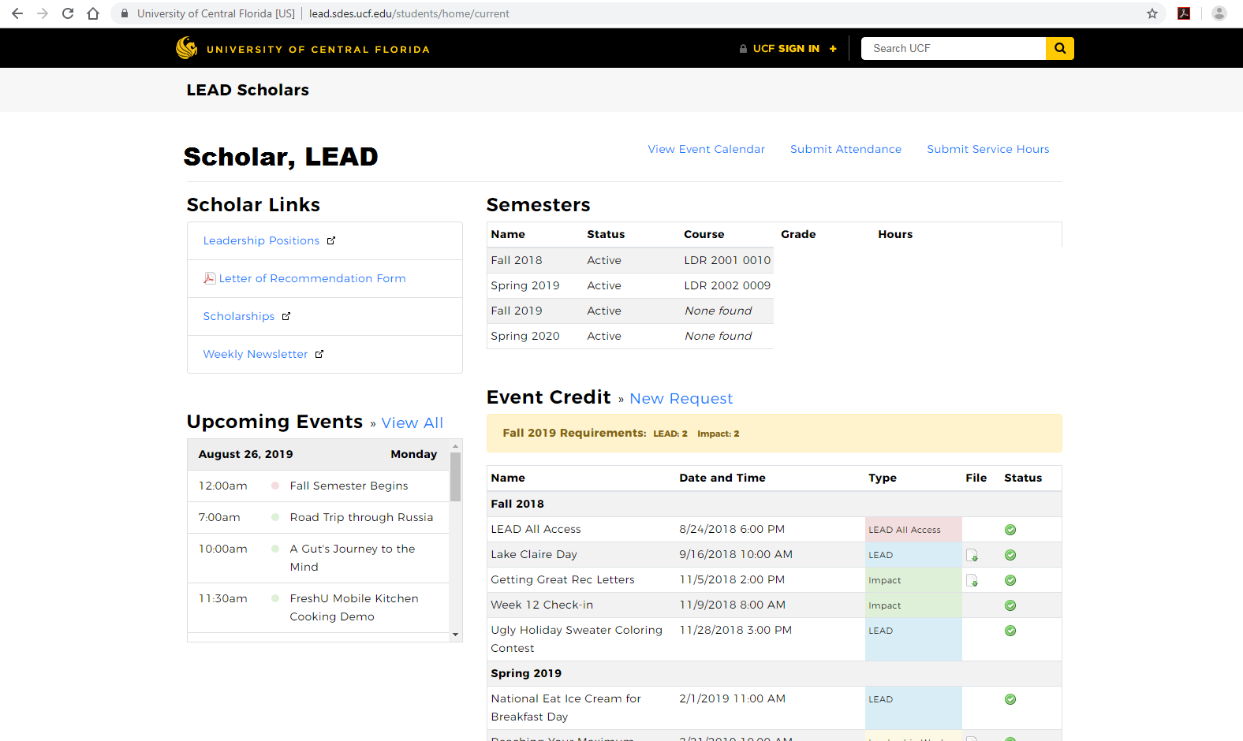
Events can be found here as well!
Notes:
Narration: This box will show upcoming events, but the link above the box will also take you to our whole calendar.

Slide 7
Upload event attendance here!
Notes:
Narration: This link is how you submit attendance for LEAD and Impact events. You will be taken to a screen where you select the event you attended, write a description of what happened, and upload your proof. Attendance must be submitted within two weeks of the event ending. Make sure your files are saved correctly, as we cannot accept some file extensions. Also double check what can and cannot be submitted as proof. With any pictures, even if event materials are requested, make sure you include your face!

Slide 8
Upload service hours here!
Notes:
Narration: This is where you submit your service hours. Forms for both Impact events and service hours can be found in the office, and the service form is your safest way to receive credit.
Submission is similar to impact events, but you must fill out a form in the portal with the contact information for the place where your service was performed, a description of what you did, and the dates you were there.
Service must be done with a non-profit organization and the form must include a thorough explanation of what you did. The authorizing agent must sign the form AFTER the service was conducted. Hours cannot be counted if they were performed to receive other class credit – including for a required assignment and extra credit – or for an internship. Passive hours, such as carpooling, donating food or supplies, or distributing pamphlets, do not count. If you have questions about what does count, please check with the front desk!
Students are required to submit fifteen hours of service in their first, second, and fourth semesters. The third semester is more focused on a specific service topic and requires students to perform twenty-five hours.

Slide 9
Make sure to check the status of your attendance!
Notes:
Narration: For every submission, you will see it immediately in your portal under Event Credit. If you don’t see your submission that means it didn’t go through! Try resubmitting or contacting the front desk for assistance.
Submissions will first have a yellow triangle icon, meaning that it is PENDING. The front desk will have received your submission and has to verify it. If your submission is approved, a green check will appear and you will receive an email letting you know it has been approved! If your submission is denied, a red x will appear and you will receive an email explaining why it was denied. You can resubmit your attendance after making any corrections. If you have further questions as to why it was denied, please contact the front desk.
Students are responsible for checking the statuses of their submissions! If you are denied attendance and do not upload any other events or hours, you run the risk of being put on Involvement Probation!

Slide 10
What counts for attendance?
A signed event form
Forms are found in the office or requested via email
A selfie taken with the event clearly taking place in the background
Be aware! Some special events also require the submission of specific event materials to count
A screenshot from a LINK event or Knight Connect confirming attendance
RSVP confirmations and pictures of sign-ins/sign-ups DO NOT COUNT
Notes:
Narration: Proof can sometimes be hard to get. Presentations can be too professional to take a selfie, and some events are hard to get a form signed. LINK and Knight Connect have their own verification processes, so screen shots with your personal information appearing on the same screen that approves attendance will also count for proof. Some larger events where you can take a selfie might require a picture of you with some materials in the event as it happens, kind of like a Clue character. If materials run out, make sure to explain that in your description.
RSVP confirmations, pictures of sign-ins or sign-ups for events, and any sort of picture that does not include your face – including pictures with your student ID but no selfie – DO NOT COUNT. The attendance will be denied and you won’t receive the credit.
As always, if you have any specific questions about the portal, events, or submitting attendance, please contact the front desk by email, phone, or by coming into the office!
And remember, the more events you attend and the more service you perform, the more Scholar Dollars you earn for the auction at the end of the spring semester.

